Slide 1
Introduction to SQL
PENGANTAR TIK PERTEMUAN 8-9
(Structured Query Language)
@rezarzky

Slide 2
Why Data Analyst MUST Learn SQL?
Not just Python/R, Tableau, Power BI, etc
SQL Database is Everywhere
SQL still the top language for data work in 2021*
*StackOverflow 2020 Developer Survey

Slide 3
What is Relational Database & SQL?

Slide 4
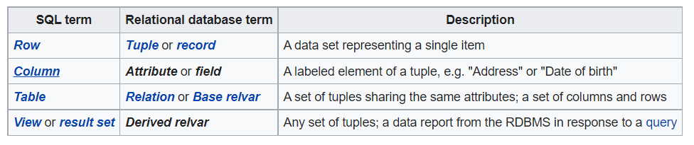
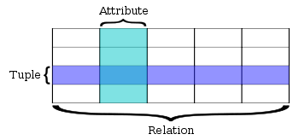
Relational Database
A relational database is a digital database based on the relational model of data, as proposed by E. F. Codd in 1970.^{[1]} A software system used to maintain relational databases is a relational database management system (RDBMS). Many relational database systems have an option of using the SQL (Structured Query Language) for querying and maintaining the database.^{[2]}
Terminology
https://en.wikipedia.org/wiki/Relational_database
Notes:
Database adalah sekumpulan data yang terorganisasi. Secara bahasa database adalah “markasnya data”. Di dalam database ada banyak tabel. Dan tabel-tabel tersebut saling berhubungan.

Slide 5
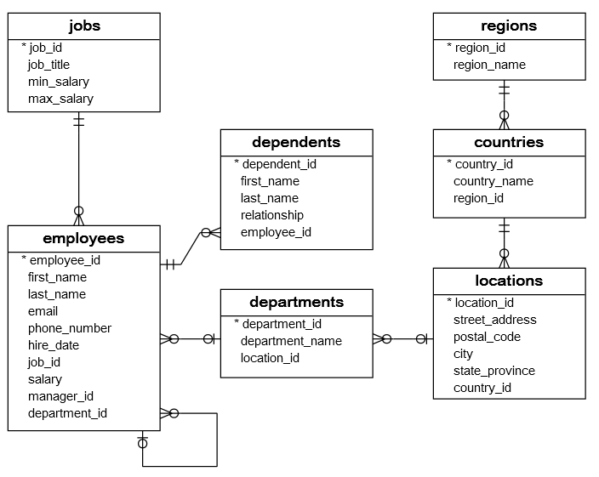
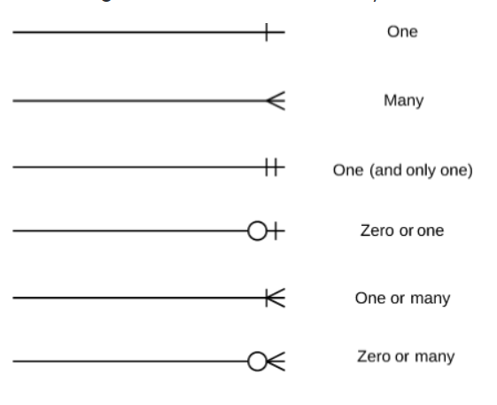
Basis Data Relasional
Entity Relationship Diagram (ERD)
Primary Key – unique and mandatory
Foreign Key – a cross- reference between tables because it references the primary key of another table
Notes:
Database Relasional
Dalam rangka efisiensi sumber daya komputasi dan menjaga integritas data, umumnya database dirancang dalam bentuk relational database, yakni data yang sama yang ada dalam berbagai tabel dipisahkan ke dalam tabel tersendiri dan digunakan bersama.
Sebuah database, terdiri atas lebih dari satu table yang saling memiliki keterkaitan satu dengan lainnya. Seperti hubungan induk dan anak.
Sebuah tabel/data terhubung dengan tabel/data lain melalui satu/beberapa kolom penghubung yang disebut sebagai key fields. Ketika akan menginduk ke tabel lain, sebuah tabel akan memiliki Foreign Key. Foreign key tersebut, mengacu pada primary key di tabel lain yang menjadi induknya.
Jenis Relasi antar tabel/data
One to One satu data dalam satu tabel terhubung ke satu data di tabel lain.
One to Many satu data dalam satu tabel terhubung ke banyak data di tabel lain.
Many to Many banyak data dalam satu tabel terhubung ke banyak data di tabel lain (biasanya menggunakan tabel bantuan).

Slide 6
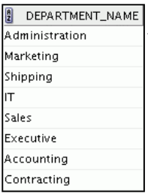
Structured Query Language (SQL) – S-Q-L /sequel
Merupakan bahasa standar ANSI untuk mengoperasikan basis data relasional
Efisien, mudah dipelajari, dan digunakan
Functionally complete (dengan SQL, kita bisa mendefinisikan, mengambil, dan memanipulasi data dalam table)
SELECT department_name FROM departments;
RDBMS
Server
Notes:
In a relational database, you do not specify the access route to the tables, and you do not need to
know how the data is arranged physically.
To access the database, you execute a structured query language (SQL) statement, which is the
American National Standards Institute (ANSI) standard language for operating relational
databases. SQL is a set of statements with which all programs and users access data in an Relational
Database.

Slide 7

Bagaimana SQL bekerja dalam aplikasi/program
Aplikasi atau program biasanya memungkinkan pengguna mengakses basis data tanpa menggunakan SQL secara langsung
SELECT department_name FROM departments;
RDBMS
Server
Hasil Query
Pengguna
Aplikasi
Notes:
Application programs often allow users access to the database
without using SQL directly, but these applications, in turn, must use SQL when executing the
user’s request.

Slide 8
RDBMS Client dan SQL Statement
Adminstrator basis data/pengembang aplikasi menggunakan client tools untuk menjalankan/mengembangkan SQL statement ke basis data
Via Client Tools
SELECT department_name FROM departments;
RDBMS
Server
Hasil Query
DbAdmin/
Programer/ Data Analyst/
Auditor
Notes:
Application programs often allow users access to the database
without using SQL directly, but these applications, in turn, must use SQL when executing the
user’s request.

Slide 9




RDBMS Client dan SQL Statement
Perlu dipastikan bahwa client tools yang digunakan kompatibel dengan RDMBS yang akan diakses
RDBMS
Client
SQL Plus
SQL developer
SQL Server Management Studio
MySQL Workbench
PgAdmin
Notes:
Beberapa RDBMS client tools dapat digunakan pada multi RDBMS

Slide 10
Tipe Data
https://www.w3schools.com/sql/sql_datatypes.asp
String
char(n)
varchar(n)
nvarchar(max)
blob
Numeric
boolean
Int, bigint
bit
float(n)
Date and Time Data Types
Datetime
Timestamp
Date
time
Other Data Types
sql_variant
xml
uniqueidentifier

Slide 11
SQL Statement
Introduction

Slide 12
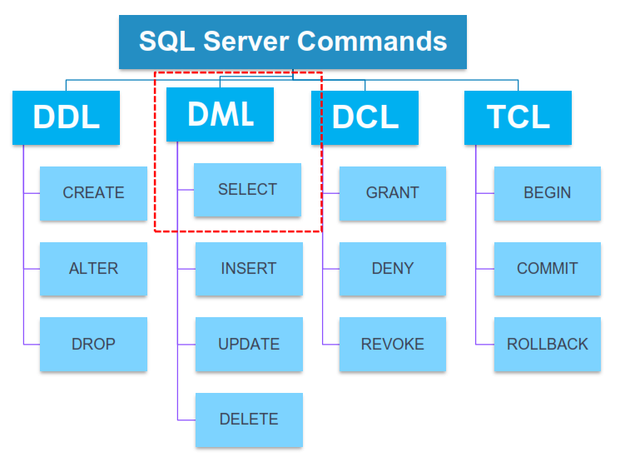
SQL statement

Slide 13
SQL Statements
Data Definition Language (DDL)
Creating database structure.
CREATE TABLE, ALTER TABLE, DROP TABLE
Data Manipulation Language (DML)
Adding and Manipulating database contents (rows).
INSERT, UPDATE, DELETE
Retrieving data from database
SELECT
Data Control Language (DCL)
GRANT, REVOKE

Slide 14
Untuk Latihan Tanpa Install Database
https://www.sqltutorial.org/seeit/

Slide 15
Writing SQL Statements
SQL statements are not case-sensitive.
SQL statements can be entered on one or more lines.
Keywords cannot be abbreviated or split across lines.
Clauses are usually placed on separate lines.
Indents are used to enhance readability.
SQL statements can optionally be terminated by a semicolon (;). Semicolons are required when you execute multiple SQL statements.
Notes:
Writing SQL Statements
By using the following simple rules and guidelines, you can construct valid statements that are both easy to read and edit:
SQL statements are not case-sensitive (unless indicated).
SQL statements can be entered on one or many lines.
Keywords cannot be split across lines or abbreviated.
Clauses are usually placed on separate lines for readability and ease of editing.
Indents should be used to make code more readable.
Keywords typically are entered in uppercase; all other words, such as table names and columns names are entered in lowercase.
Executing SQL Statements
In SQL Developer, click the Run Script icon or press [F5] to run the command or commands in the SQL Worksheet. You can also click the Execute Statement icon or press [F9] to run a SQL statement in the SQL Worksheet. The Execute Statement icon executes the statement at the mouse pointer in the Enter SQL Statement box while the Run Script icon executes all the statements in the Enter SQL Statement box. The Execute Statement icon displays the output of the query on the Results tabbed page while the Run Script icon emulates the SQL*Plus display and shows the output on the Script Output tabbed page.
In SQL*Plus, terminate the SQL statement with a semicolon, and then press [Enter] to run the command.

Slide 16
SQL Statement
BASIC QUERIES
SELECT – FROM – WHERE

Slide 17
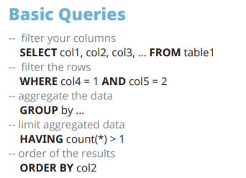
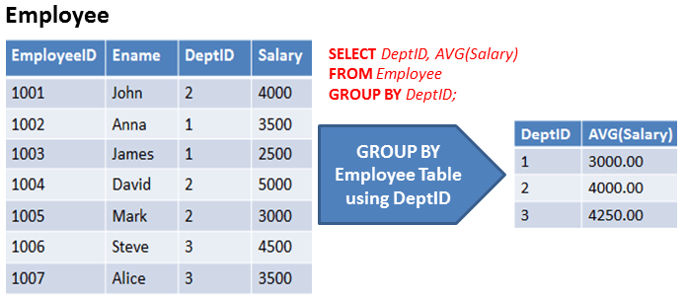
- SELECT

Slide 18
SQL Query Order of Execution
JOIN + FROM
Chose and join tables to get data
WHERE
Filter the data
GROUP BY
Aggregate the base data
HAVING
Filter the aggregated data
SELECT
Returns final data
ORDER BY
Sorts the final data
LIMIT
Limit the returned data to a row count

Slide 19
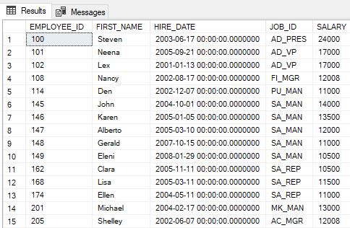
SELECT:Anatomi SELECT Statement – Fungsi/Kegunaan
Kolom/field yang akan ditampilkan
SELECT EMPLOYEE_ID, FIRST_NAME, HIRE_DATE, JOB_ID, SALARY
FROM EMPLOYEES
WHERE SALARY > 10000;
Tabel yang digunakan
Row yang akan diambil adalah row dengan gaji di atas 10.000

Slide 20
SELECT Limiting the Column that Are Selected
Menampilkan Semua Kolom:
SELECT * FROM nama_tabel
Menampilkan Kolom yang Spesifik
SELECT nama_kolom, nama_kolom2
Menampilkan Hanya Record yang Unique
SELECT DISTINCT nama_kolom
Menggunakan Alias untuk Nama Kolom
SELECT nama_kolom as alias_kolom
SELECT nama_kolom alias_kolom

Slide 21

SELECT Menggunakan Ekspresi Aritmatik
Operator
Description
SELECT last_name, salary, 12*(salary+100)
FROM employees;
+
Add
-
Subtract
*
Multiply
/
Divide

Slide 22
- Restricting and Sorting Data

Slide 23
SQL Query Order of Execution
JOIN + FROM
Chose and join tables to get data
WHERE
Filter the data
GROUP BY
Aggregate the base data
HAVING
Filter the aggregated data
SELECT
Returns final data
ORDER BY
Sorts the final data
LIMIT
Limit the returned data to a row count

Slide 24
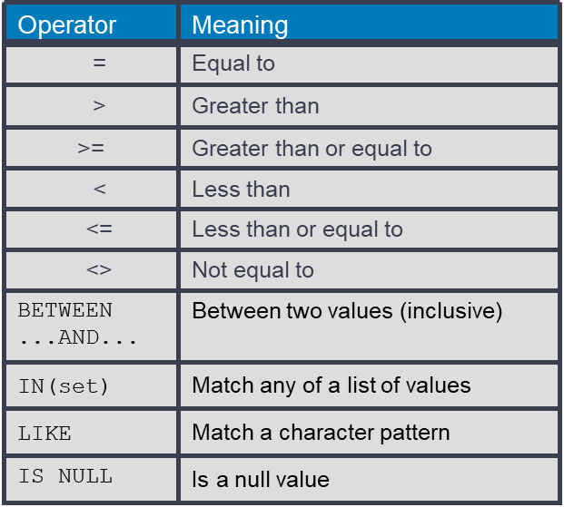

WHERE Limiting the Rows that Are Selected
SELECT *|{[DISTINCT] column|expression [alias],...}
FROM table
[WHERE condition(s)];
Comparison Operators
Example
SELECT employee_id, last_name, job_id, department_id
FROM employees
WHERE department_id = 90 ;

Slide 25
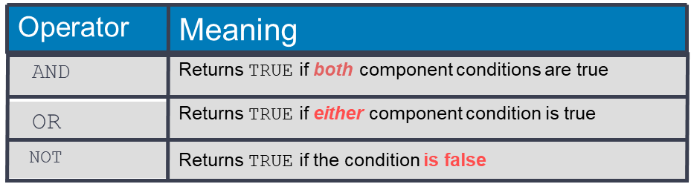
WHERE Limiting the Rows that Are Selected
Pattern Matching Using the LIKE Operator
Use the LIKE operator to perform wildcard searches of valid search string values.
Search conditions can contain either literal characters or numbers:
% denotes zero or many characters.
_ denotes one character.
Using the NULL Conditions
The NULL conditions include the IS NULL condition and the IS NOT NULL condition.
WHERE with more than one conditions: AND, OR, NOT
SELECT first_name
FROM employees
WHERE first_name LIKE 'S%' ;
SELECT last_name, manager_id
FROM employees
WHERE manager_id IS NULL ;
SELECT employee_id, last_name, job_id, salary
FROM employees
WHERE salary >= 10000
AND job_id LIKE '%MAN%' ;

Slide 26
ORDER BY Sorting Data
Mengurutkan data menggunakan ORDER BY:
ASC: Ascending order, default
DESC: Descending order
Contoh:
SELECT last_name, job_id, department_id, hire_date
FROM employees
ORDER BY hire_date ASC;
Mengurutkan berdasarkan kolom hire_date dengan urutan ascending
SELECT employee_id, last_name, salary*12 annsal
FROM employees
ORDER BY annsal ;
Mengurutkan berdasarkan nama alias annsal
SELECT last_name, department_id, salary
FROM employees
ORDER BY 2, salary DESC;
Mengurutkan menggunakan beberapa kolom, salah satunya menggunakan posisi dari kolom di SELECT

Slide 27
Quest!
Siapakah pemilik Gaji Tertinggi di Perusahaan
Karen Colmenares
Steven King
Lex De Haan
Guy Himuro

Slide 28
Quest 2!
Siapakah pegawai yang tidak mempunyai manager?
Karen Colmenares
Steven King
Lex De Haan
Guy Himuro

Slide 29
- Aggregating & Limit Aggregated Data

Slide 30
SQL Query Order of Execution
JOIN + FROM
Chose and join tables to get data
WHERE
Filter the data
GROUP BY
Aggregate the base data
HAVING
Filter the aggregated data
SELECT
Returns final data
ORDER BY
Sorts the final data
LIMIT
Limit the returned data to a row count

Slide 31
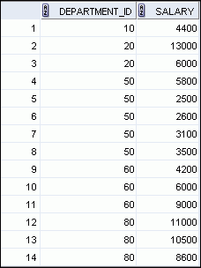
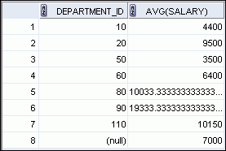

Creating Groups of Data
EMPLOYEES
Average salary in
EMPLOYEES table for
each department
4400
9500
3500
6400
10033
…
Notes:
Creating Groups of Data
Until this point in our discussion, all group functions have treated the table as one large group of information. At times, however, you need to divide the table of information into smaller groups. This can be done by using the GROUP BY clause.

Slide 32
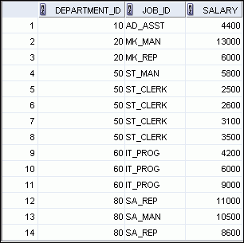
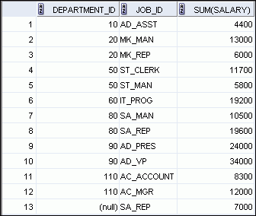

Grouping by More than One Column
EMPLOYEES
Add the salaries in the EMPLOYEES
table for each job, grouped by department.
…
Notes:
Grouping by More than One Column
Sometimes you need to see results for groups within groups. The slide shows a report that displays the total salary that is paid to each job title in each department.
The EMPLOYEES table is grouped first by the department number and then by the job title within that grouping. For example, the four stock clerks in department 50 are grouped together, and a single result (total salary) is produced for all stock clerks in the group.

Slide 33
GROUP BY Aggregating Data
SELECT column, group_function(column)
FROM table
[WHERE condition]
[GROUP BY group_by_expression]
[ORDER BY column];
Group Function
Example
AVG
COUNT
MAX
MIN
SUM
STDDEV
VARIANCE
SELECT department_id dept_id, job_id, SUM(salary),
COUNT(department_id)
FROM employees
WHERE salary > 1000
GROUP BY department_id, job_id
ORDER BY department_id;
Notes:
Creating Groups of Data: GROUP BY Clause Syntax
You can use the GROUP BY clause to divide the rows in a table into groups. You can then use the group functions to return summary information for each group.
In the syntax:
group_by_expression specifies columns whose values determine the basis for grouping rows
Guidelines
If you include a group function in a SELECT clause, you cannot select individual results as well, unless the individual column appears in the GROUP BY clause. You receive an error message if you fail to include the column list in the GROUP BY clause.
Using a WHERE clause, you can exclude rows before dividing them into groups.
You must include the columns in the GROUP BY clause.
You cannot use a column alias in the GROUP BY clause.
Using the Group By Clause on Multiple Columns
You can return summary results for groups and subgroups by listing more than one GROUP BY column. You can determine the default sort order of the results by the order of the columns in the GROUP BY clause. In the example in the slide, the SELECT statement containing a GROUP BY clause is evaluated as follows:
The SELECT clause specifies the column to be retrieved:
Department number in the EMPLOYEES table
Job ID in the EMPLOYEES table
The sum of all salaries in the group that you specified in the GROUP BY clause
The FROM clause specifies the tables that the database must access: the EMPLOYEES table
The GROUP BY clause specifies how you must group the rows:
First, the rows are grouped by the department number.
Second, the rows are grouped by job ID in the department number groups.
So the SUM function is applied to the salary column for all job IDs in each department number group.

Slide 34
HAVING Filtetring Aggregating Data
SELECT column, group_function
FROM table
[WHERE condition]
[GROUP BY group_by_expression]
[HAVING group_condition]
[ORDER BY column];
Filtering data yang telah di grouping
Mirip dengan WHERE
Notes:
Restricting Group Results with the HAVING Clause
You use the HAVING clause to specify the groups that are to be displayed, thus further restricting the groups on the basis of aggregate information.
In the syntax, group_condition restricts the groups of rows returned to those groups for which the specified condition is true.
The Oracle server performs the following steps when you use the HAVING clause:
1. Rows are grouped.
2. The group function is applied to the group.
3. The groups that match the criteria in the HAVING clause are displayed.
The HAVING clause can precede the GROUP BY clause, but it is recommended that you place the GROUP BY clause first because it is more logical. Groups are formed and group functions are calculated before the HAVING clause is applied to the groups in the SELECT list.

Slide 35
SQL Statement
Queries on Multiple Table
JOIN – SET OPERATIONS - SUBQUERY

Slide 36
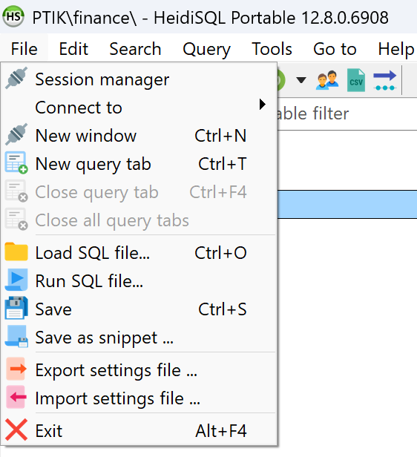
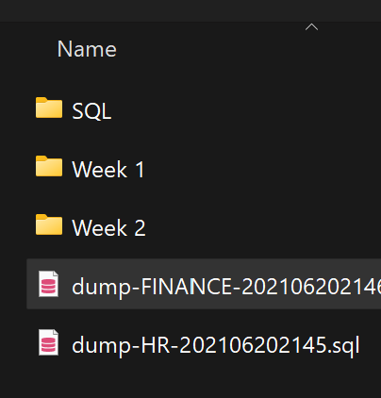
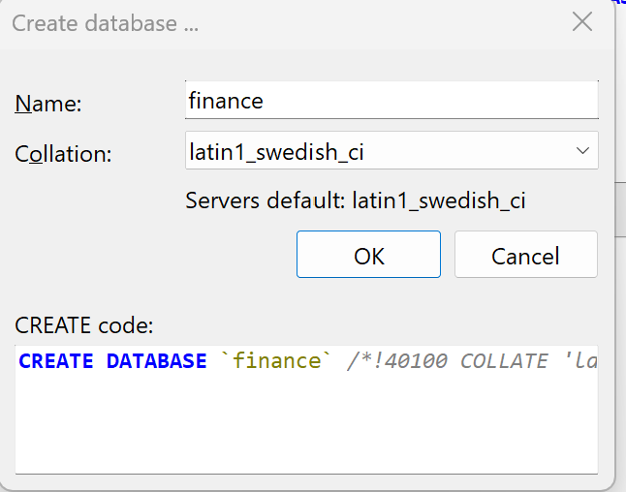
Load Data Baru
Klik Kanan Create New Database
Namakan: “finance”
Cek database Finance.
Kemudian di File Pilih
Run SQL File
Pilih file dari dumpdata.zip
dump-FINANCE…
Pilih OK kemudian YES

Slide 37
FUNCTION

Slide 38
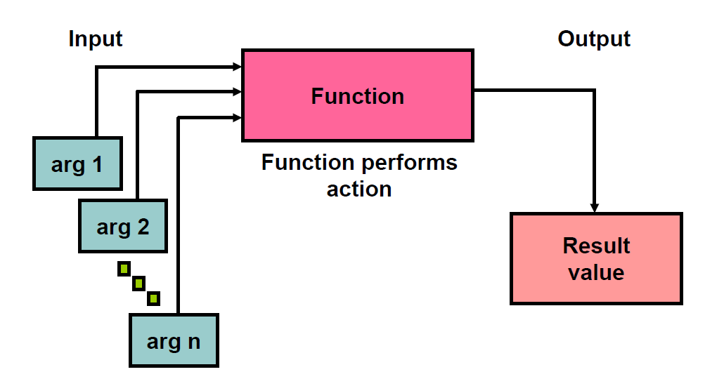
BUILD-IN FUNCTION

Slide 39
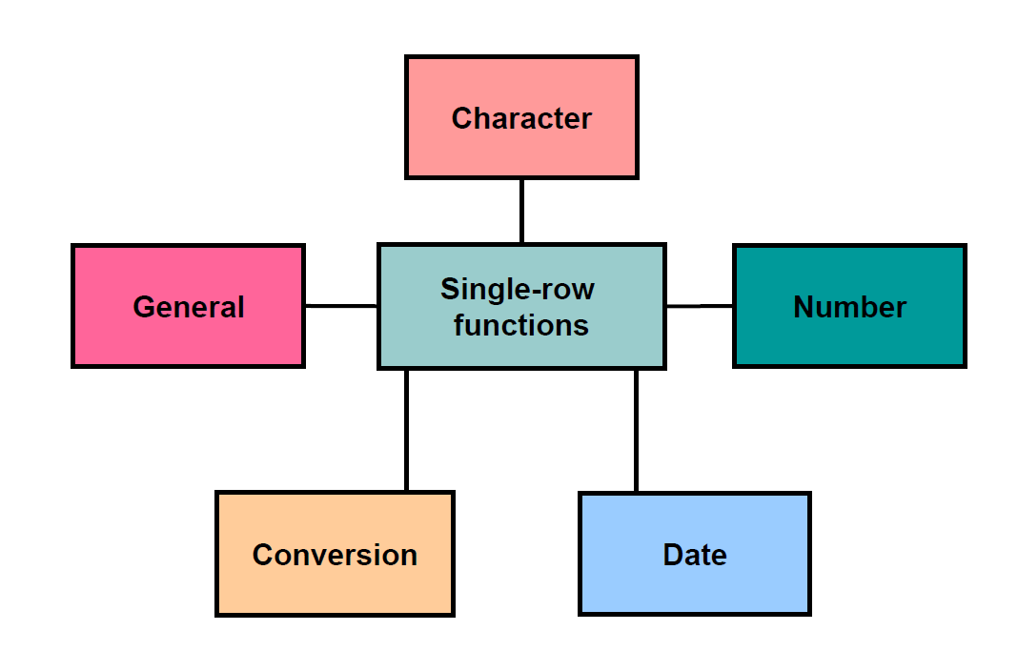
BUILD-IN FUNCTION: SINGLE ROW
https://www.w3schools.com/mysql/mysql_ref_functions.asp

Slide 40
SINGLE ROW FUNCTIONS STRING FUNCTIONS
INPUT
FUNCTION
OUTPUT
TABK | LOWER(INPUT) | tabk
Pengantar TIK | UPPER(INPUT) | PENGANTAR TIK
Pengantar TIK | CONCAT(a, ‘ ‘, b) | Pengantar TIK
Pengantar TIK | SUBSTRING(1, 3) | Peng
SQL | LENGTH(INPUT) | 3
‘1234567 ‘ | TRIM(INPUT) | ‘1234567’
BELAJAR ACL | REPLACE(INPUT, ‘ACL’, ‘SQL’) | BELAJAR SQL
dan sebagainya.

Slide 41
SINGLE ROW FUNCTIONS NUMERIC FUNCTIONS
ROUND(column|expression, n, m) | Rounds the column, expression, or value to n decimal, m <> 0 truncate, m= 0 default
ABS(column|expression) | Returns the absolute value of a number.
dan sebagainya.

Slide 42
SINGLE ROW FUNCTIONS DATE FUNCTIONS
CURRENT_DATE(): Memberikan Tanggal saat ini
MONTH(DATE_TIME_COL) : Memberikan bulan dari Datetime: 1-12
DAY(DATE_TIME_COL): Memberikan tanggal dari Datetime: 1-31
YEAR(DATE_TIME_COL): Mengambil Tahun dari Datetime
MONTHNAME(DATE_TIME_COL): Mengambil Nama Bulan dari Datetime
DAYOFWEEK("2017-06-15“): Memberikan Hari: 1=Sunday, 2=Monday, 3=Tuesday, 4=Wednesday, 5=Thursday, 6=Friday, 7=Saturday
TIMESTAMPDIFF(MONTH/DAY/YEAR, OLD_DATE, NEW_DATE): Memberikan selisih antara waktu dengan waktu yang lain
dan sebagainya.

Slide 43
JOINING

Slide 44

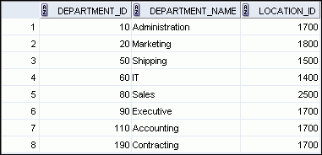

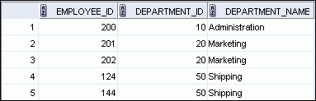

Obtaining Data from Multiple Tables
EMPLOYEES
DEPARTMENTS
…
…
Notes:
Obtaining Data from Multiple Tables
Sometimes you need to use data from more than one table. In the example in the slide, the report displays data from two separate tables:
Employee IDs exist in the EMPLOYEES table.
Department IDs exist in both the EMPLOYEES and DEPARTMENTS tables.
Department names exist in the DEPARTMENTS table.
To produce the report, you need to link the EMPLOYEES and DEPARTMENTS tables, and access data from both of them.

Slide 45
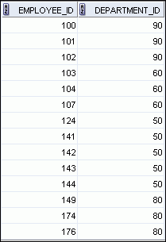
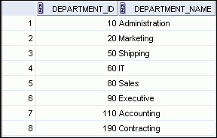
Joining Column Names Join adalah menggabungkan 2 tabel menggunakan kolom penghubung yang sering disebut sebagai key Key adalah salah satu kolom di masing-masing tabel yang akan di-join yang memiliki format sama
EMPLOYEES
DEPARTMENTS
Primary key
…
Foreign key
Notes:
Joining Column Names
To determine an employee’s department name, you compare the value in the DEPARTMENT_ID column in the EMPLOYEES table with the DEPARTMENT_ID values in the DEPARTMENTS table. The relationship between the EMPLOYEES and DEPARTMENTS tables is an equijoin; that is, values in the DEPARTMENT_ID column in both the tables must be equal. Frequently, this type of join involves primary and foreign key complements.
Note: Equijoins are also called simple joins or inner joins.

Slide 46
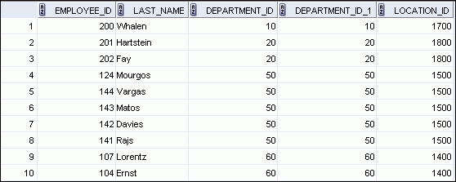
Retrieving Records with the ON Clause
SELECT e.employee_id, e.last_name, e.department_id,
d.department_id, d.location_id
FROM employees e JOIN departments d
ON (e.department_id = d.department_id);
…
Notes:
Retrieving Records with the ON Clause
In this example, the DEPARTMENT_ID columns in the EMPLOYEES and DEPARTMENTS table are joined using the ON clause. Wherever a department ID in the EMPLOYEES table equals a department ID in the DEPARTMENTS table, the row is returned. The table alias is necessary to qualify the matching column_names.
You can also use the ON clause to join columns that have different names. The parenthesis around the joined columns as in the slide example, (e.department_id = d.department_id) is optional. So, even ON e.department_id = d.department_id will work.
Note: SQL Developer suffixes a ‘_1’ to differentiate between the two department_ids.

Slide 47
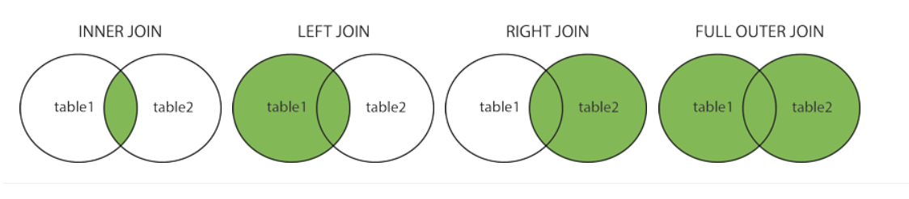
JOIN
Join adalah menggabungkan 2 tabel menggunakan kolom penghubung yang sering disebut sebagai key
Key adalah salah satu kolom di masing-masing tabel yang akan di-join yang memiliki format sama
Terdapat empat kemungkinan join sebagai berikut:
returning only matched rows
inner join + unmatched rows from the left/right
returning all
Contoh: SELECT * FROM table1 INNER JOIN table2 ON table2.CustomerID=table1.CustomerID;
Notes:
INNER Versus OUTER Joins
Joining tables with the NATURAL JOIN, USING, or ON clauses results in an inner join. Any unmatched rows are not displayed in the output. To return the unmatched rows, you can use an outer join. An outer join returns all rows that satisfy the join condition and also returns some or all of those rows from one table for which no rows from the other table satisfy the join condition.
There are three types of outer joins:
LEFT OUTER
RIGHT OUTER
FULL OUTER

Slide 48
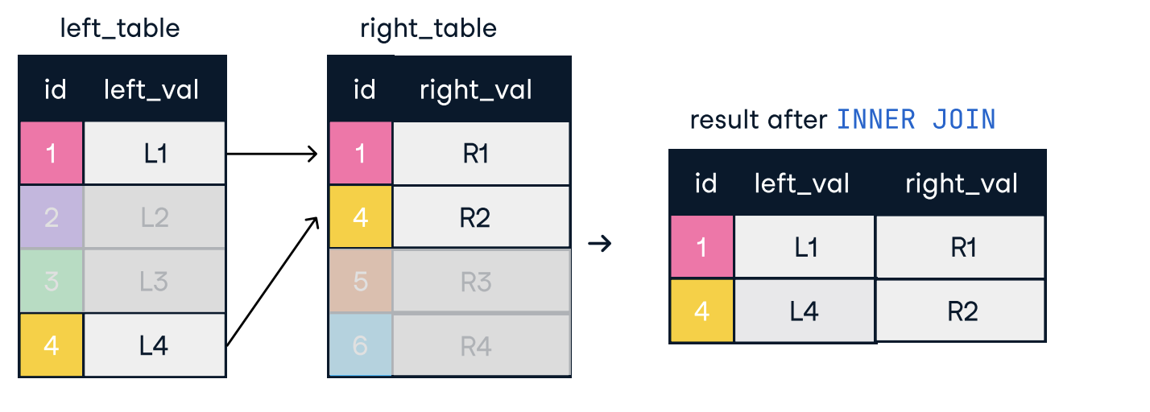
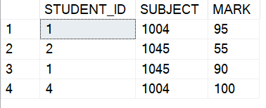
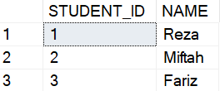
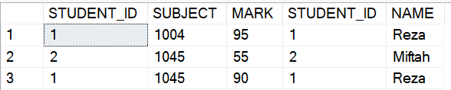
Inner Join /Join
Inner join antara dua tabel hanya mengambil data-data yang kolom penghubungnya (seperti key), menemukan kecocokan di kedua tabel.
SELECT *
FROM NILAI nil
INNER JOIN aasSTUDENT std
ON nil.STUDENT_ID = std.STUDENT_ID
dbo.NILAI
dbo.STUDENT
hasil

Slide 49
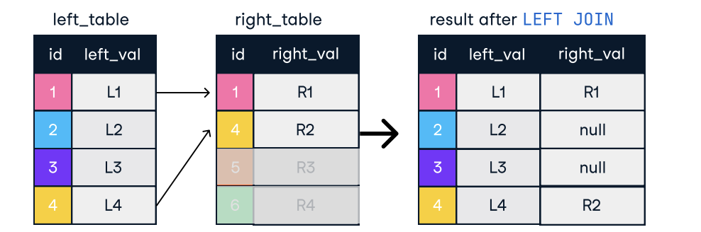
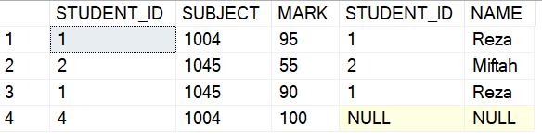
Left Join
Left join antara dua tabel: mengambil seluruh data dari tabel kiri (di FROM) dan mengembalikan nilai Null dari tabel kanan pada data yang key-nya tidak cocok.
SELECT *
FROM NILAI nil
LEFT JOIN STUDENT std
ON nil.STUDENT_ID = std.STUDENT_ID
dbo.NILAI
dbo.STUDENT
hasil

Slide 50
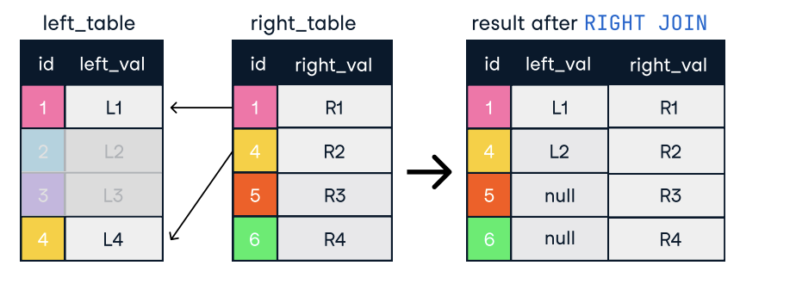
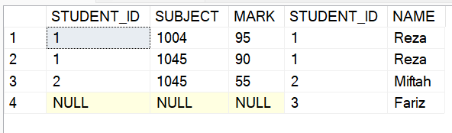
Right Join
Right join antara dua tabel: sama seperti left join tapi yang diambil semua sebelah kanan
SELECT *
FROM dbo.NILAI nil
RIGHT JOIN dbo.STUDENT std
ON nil.STUDENT_ID = std.STUDENT_ID
dbo.NILAI
dbo.STUDENT
hasil

Slide 51
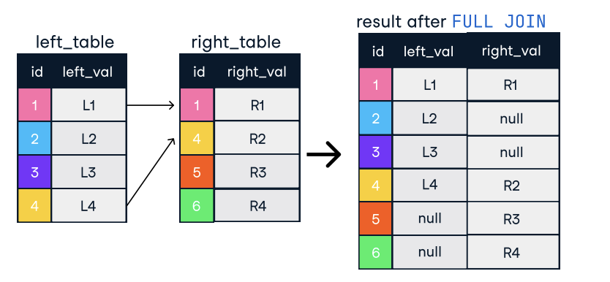
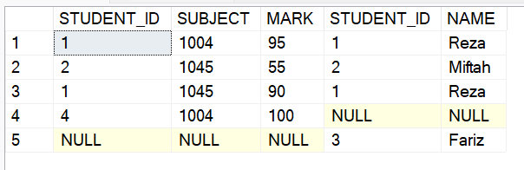
Full Join
Kombinasi right dan left join. Tabel kanan dan kiri diambil semua, ketika key tidak match akan ditampilkan Null.
SELECT *
FROM dbo.NILAI nil
FULL JOIN dbo.STUDENT std
ON nil.STUDENT_ID = std.STUDENT_ID
dbo.NILAI
dbo.STUDENT
hasil

Slide 52
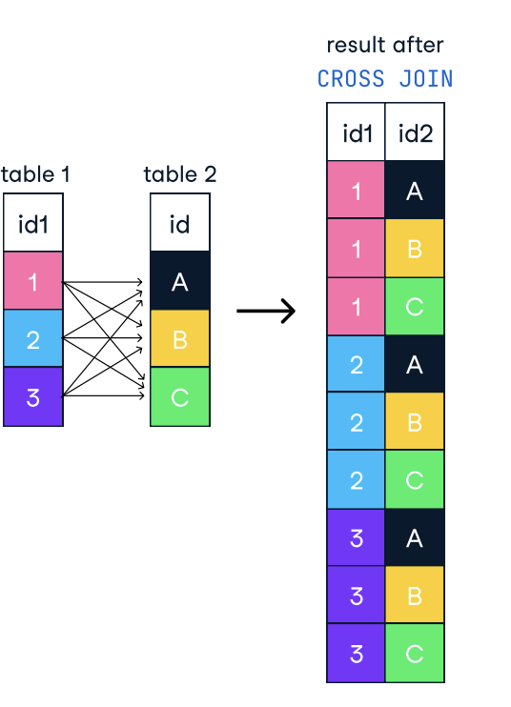
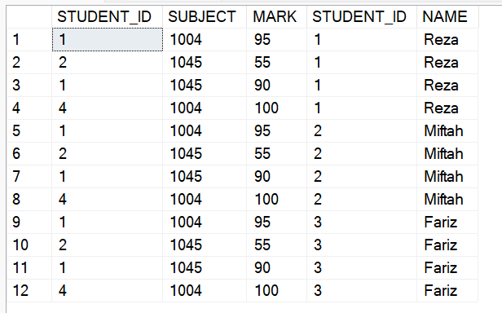
CROSS JOIN
Membuat kombinasi seluruh data
SELECT *
FROM dbo.NILAI
CROSS JOIN dbo.STUDENT
atau
SELECT *
FROM dbo.NILAI, dbo.STUDENT
dbo.NILAI
dbo.STUDENT
hasil

Slide 53
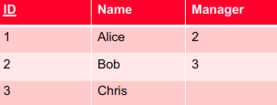
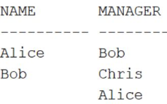
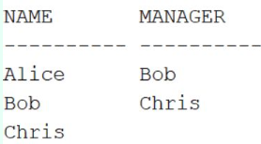
Apa hasil Query ini?
Employee table:
SELECT e1.NAME as name,
e2.name as manager
FROM employee e1
RIGHT JOIN employee e2
ON e1.manager = e2.id;
A
B

Slide 54


Employee
Project
“ untuk tiap employee, berapa total jumlah biaya project atas semua project yang ditugaskan kepada mereka?”
A. SELECT e.name, sum(cost) as total FROM employee e RIGHT JOIN project p on e.id = p.empid GROUP BY e.name;
B. SELECT e.name, ISNULL(sum(cost),0) as total FROM employee e LEFT JOIN project p on e.id = p.empid GROUP BY e.name;
D. SELECT e.name, sum(cost) as total FROM employee e FULL JOIN project p on e.id = p.empid GROUP BY e.name;

Slide 55
Buat Query
“Tampilkan employee yang menerima salary tidak sesuai dengan ketentuan salary?”
Ketentuan salary di table Employees
Pembayaran gaji di table Payroll
Tampilkan Employee ID, First Name, Salary Real, Salary sesuai ketentuan, tahun, bulan

Slide 56
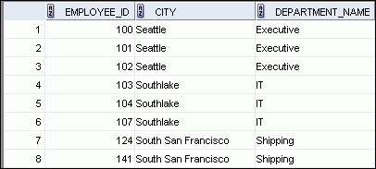
Creating Three-Way Joins with the ON Clause
SELECT employee_id, city, department_name
FROM employees e
JOIN departments d
ON d.department_id = e.department_id
JOIN locations l
ON d.location_id = l.location_id;
…
Notes:
Creating Three-Way Joins with the ON Clause
A three-way join is a join of three tables. In SQL:1999–compliant syntax, joins are performed from left to right. So, the first join to be performed is EMPLOYEES JOIN DEPARTMENTS. The first join condition can reference columns in EMPLOYEES and DEPARTMENTS but cannot reference columns in LOCATIONS. The second join condition can reference columns from all three tables.
Note: The code example in the slide can also be accomplished with the USING clause:
SELECT e.employee_id, l.city, d.department_name
FROM employees e
JOIN departments d
USING (department_id)
JOIN locations l
USING (location_id)

Slide 57
TAMPILKAN:
FIRST_NAME (EMPLOYEE)
DEPARTMENT_ID (EMPLOYEE)
DEPARTMENT_NAME (DEPARTMENT)
--------
CITY (LOCATIONS)
TAMPILKAN:
FIRST_NAME (EMPLOYEE)
MANAGER_ID (EMPLOYEE)
INFORMASI NAMA MANAGER (EMPLOYEE)

Slide 58
TAMPILKAN:
DEPARTMENT_NAME
CITY
COUNTRY_NAME
REGION_NAME

Slide 59
SET OPERATION

Slide 60
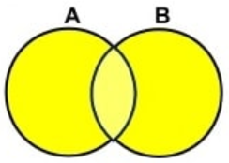
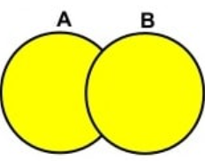
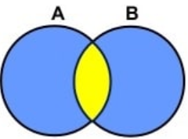
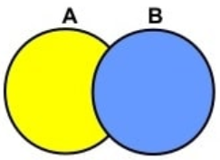
Relational Set Operations
UNION COMPATIBLE
Same number of attributes
Similar datatypes
UNION ALL
UNION
INTERSECT
EXCEPT
Semua row digabungkan. Walau ada row duplikat
Semua row digabungkan dan row yang duplikat di hilangkan (disisakan satu). Distinct dari UNION ALL
Ditampilkan row duplikat (ada di kedua sisi), namun hanya distinct row yang disisakan
Ditampilkan row dari sisi yang tidak ada di kanan

Slide 61
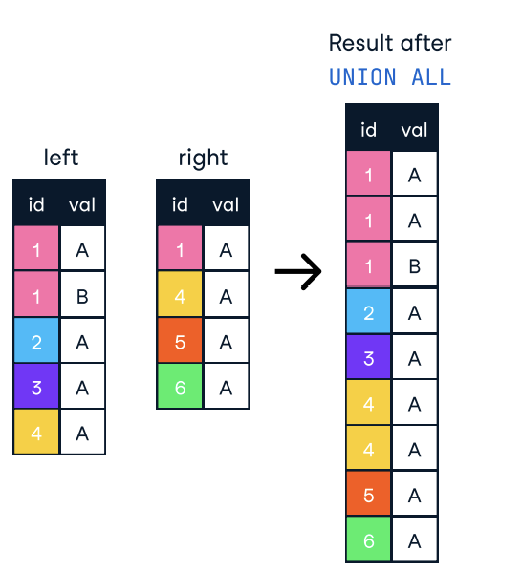
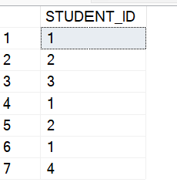
UNION ALL
Semua row digabungkan. Walau ada row duplikat
SELECT STUDENT_ID
FROM STUDENT
UNION ALL
SELECT STUDENT_ID
FROM NILAI
dbo.NILAI
dbo.STUDENT
hasil

Slide 62
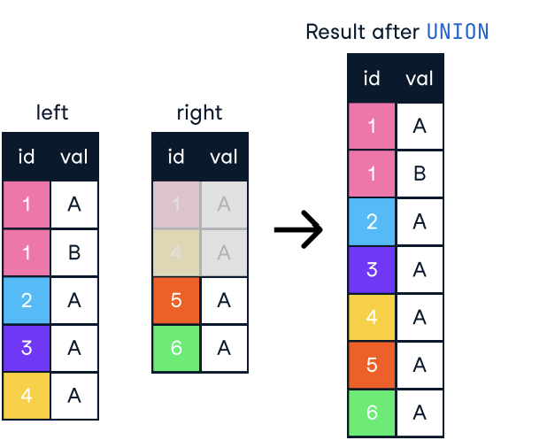
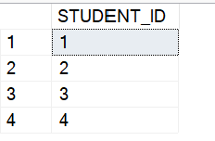
UNION
Semua row digabungkan yang duplikat tidak ikut
SELECT STUDENT_ID
FROM dbo.STUDENT
UNION
SELECT STUDENT_ID
FROM dbo.NILAI
dbo.NILAI
dbo.STUDENT
hasil

Slide 63


INTERSECT
Semua row digabungkan yang duplikat tidak ikut
SELECT STUDENT_ID
FROM dbo.STUDENT
INTERSECT
SELECT STUDENT_ID
FROM dbo.NILAI
dbo.NILAI
dbo.STUDENT
hasil

Slide 64

EXCEPT
Ditampilkan row dari sisi yang tidak ada di kanan.
SELECT STUDENT_ID
FROM dbo.STUDENT
EXCEPT
SELECT STUDENT_ID
FROM dbo.NILAI
dbo.NILAI
dbo.STUDENT
hasil

Slide 65

C. SUBBQUERY
Menjalankan Query di Dalam Query
SELECT last_name, salary
FROM employees
WHERE salary >
(SELECT salary
FROM employees
WHERE last_name = 'Abel');
Main Query
Sub Query

Slide 66



Types of Subquery
C. SUBBQUERY
Single Value
Multiple Value, many rows and columns
Multiple Value, many row but one column

Slide 67
Apa yang dihasilkan dari subquery ini
SELECT *
FROM employees
WHERE salary > (SELECT avg(salary)
FROM employees
GROUP BY department_id);
A. A value (a single column, single row).
B. A list of values.
C. Multiple columns, multiple rows.
D. None of the above.

Slide 68
Apa yang dihasilkan dari subquery ini
SELECT *
FROM EMPLOYEES
WHERE SALARY IN (SELECT MAX(SALARY)
FROM EMPLOYEES
GROUP BY DEPARTMENT_ID)
A. A value (a single column, single row).
B. A list of values.
C. Multiple columns, multiple rows.
D. None of the above.

Slide 69
Single-Row Subquery
Multi-Row Subquery
Return only one row
Use single-row comparison operators
Return more than one row
Use multiple-row comparison operators
Operator
Meaning
Operator
Meaning
IN
Equal to any member in the list
=
Equal to
ANY
Must be preceded by =, !=, >, <, <=, >=. Compares a value to each value in a list or returned by a query. Evaluates to FALSE if the query returns no rows.
>
Greater than
>=
Greater than or equal to
<
Less than
ALL
Must be preceded by =, !=, >, <, <=, >=. Compares a value to every value in a list or returned by a query. Evaluates to TRUE if the query returns no rows.
<=
Less than or equal to
<>
Not equal to

Slide 70
CASE WHEN

Slide 71
SQL CASE Statement
Perintah CASE sering digunakan untuk menampilkan nilai tertentu dari beberapa barisan data dengan syarat-syarat atau kondisi yang kita berikan.
Contoh:
SELECT nama, CASE alamat
WHEN 'PMK' THEN 'PAMEKASAN'
WHEN 'SMP' THEN 'SAMPANG'
ELSE alamat END AS kota_lahir
FROM table_kota
SELECT FIRST_NAME,
CASE
WHEN SALARY >6000 THEN 'High'
ELSE 'Low'
END as category
FROM EMPLOYEES

Slide 72
THANKS!

Slide 73
Reference
https://www.w3schools.com/sql/
https://en.wikipedia.org/wiki/Relational_database
https://www.sqltutorial.org/sql-sample-database/
PPT Template: https://www.slidescarnival.com/

