Slide 1

ASP 2509: Pengantar Teknologi Informasi
Sistem Operasi dan Perangkat Lunak
Reza R Pratama
Minggu ke-3

Slide 2
Roadmap Pengantar TIK
Konsep TI dan SI, serta peran pentingnya bagi organisasi
Internet, keamanan informasi & etika dalam penggunaan TI dan internet
Arsitektur dasar perangkat keras komputer
Sistem operasi dan perangkat lunak
Jaringan dan telekomunikasi
Spreadsheet untuk mengolah data
Basis data
Visualisasi data
Konsep Big Data, Data Mining, Machine Learning dan AI (Artificial Intelegent)
Data mining sederhana
Konsep dasar pemrograman
Aplikasi perkantoran (Microsoft Office dan Aplikasi Akuntansi sederhana)

Slide 3
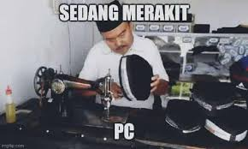
Mending Rakit PC: Common Mistakes
Tidak Mengimbangi Komponen (Bottlenecking)
Overbudget pada Satu Komponen dan Mengabaikan Lainnya
Tidak Memikirkan Kebutuhan Penyimpanan yang Cukup
Pembelian Komponen yang Berlebihan (Lebih dari 1 pcs tanpa justifikasi)
MEMBELI MINI PC / LAPTOP PADA TUGAS RAKIT PC

Slide 4
AKTIVITAS I
BERIKAN CONTOH PENGEMBANGAN SISTEM INFORMASI YANG GAGAL. MENGAPA?

Slide 5
AKTIVITAS II
JELASKAN:
KAPAN HARUS UPGRADE RAM?
KAPAN HARUS UPDATE HARDISK?

Slide 6
Sistem Operasi dan Perangkat Lunak
Illustrated

Slide 7
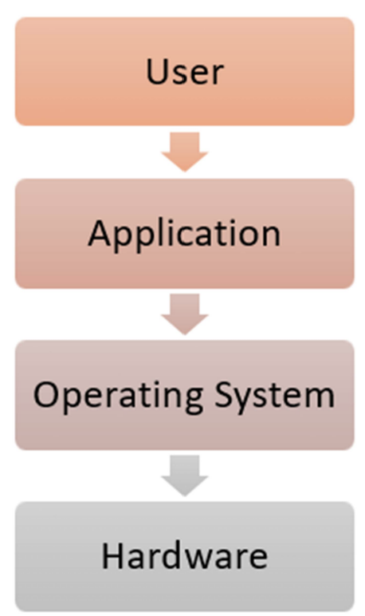
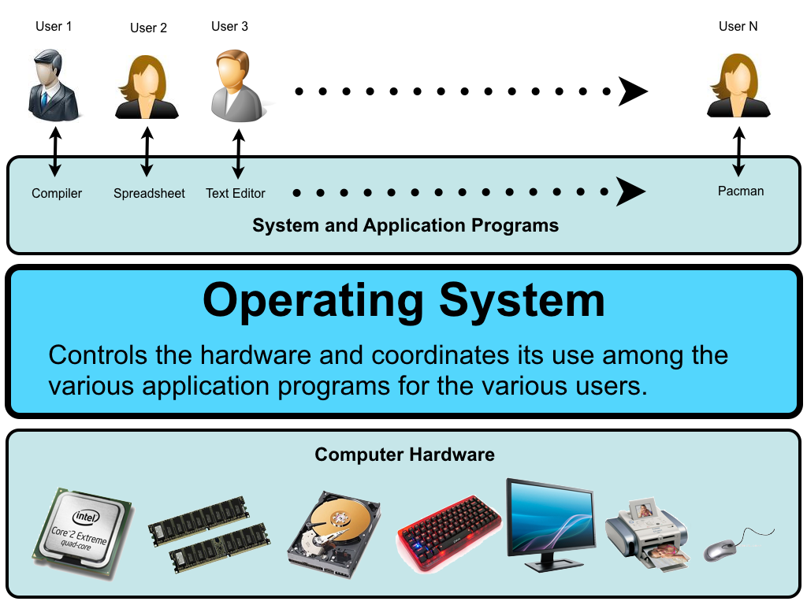
Hardware – OS – Application

Slide 8

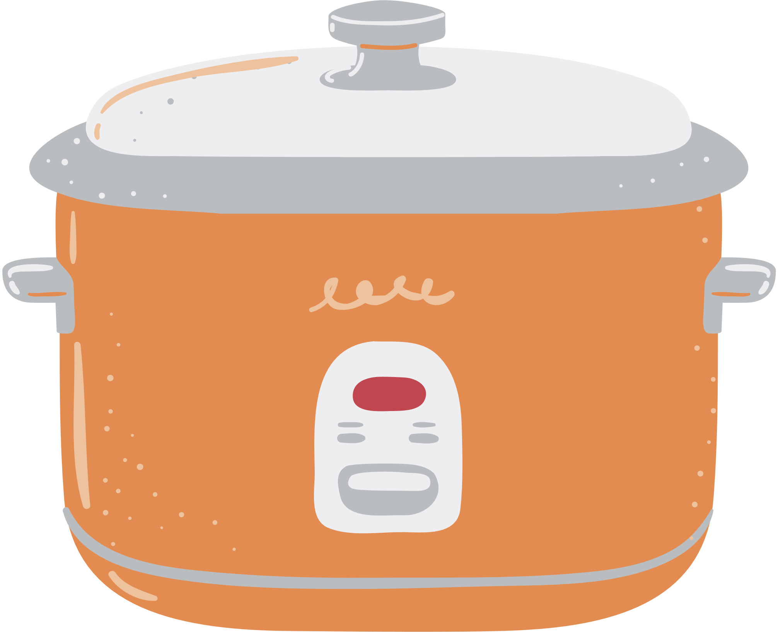
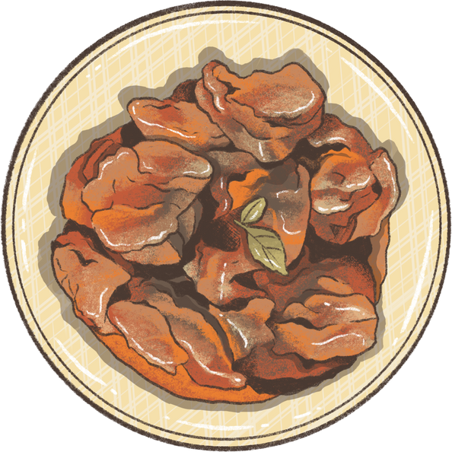

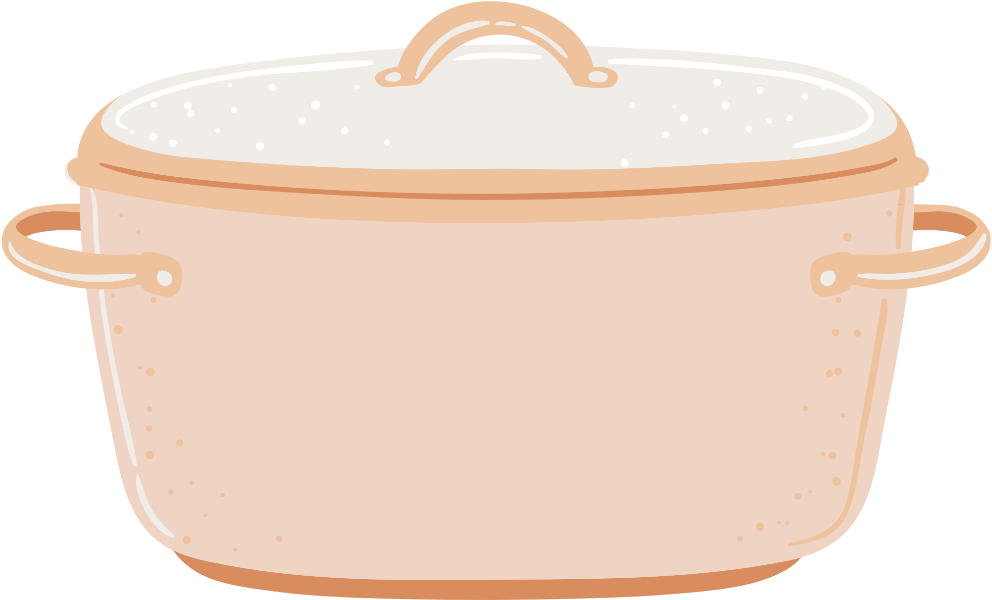
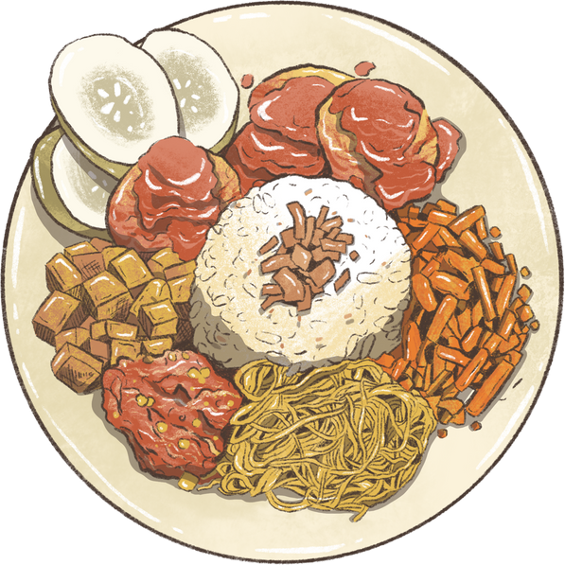







Hardware – OS – Application: Illustrated as a Restaurant
Dishes on Menu as Apps
Chef & Personnels as Software
Kitchen as Hardware
Notes:
Hardware = the physical tools and staff that make things possible
OS = the key personnel that ensures smooth operation and communication,
Applications = the specific dishes (tasks) you enjoy that require coordination of all parts

Slide 9

Hardware – OS – Application: Illustrated as a Restaurant (breakdown)
Shell/GUI as Waiters
Kernel as Chef
Dishes on Menu
as Apps
File System
as Pantry
Kitchen as Hardware
Notes:
Hardware is the kitchen and tools that make the restaurant possible.
The Kernel is like the core library management system: the chef managing how each task gets processed and served.
File System is the organizer, arranging and tracking all files in an orderly fashion. It ensures every ingredient (file) is labeled, stored correctly, and easy to find when needed.
The shell makes it easy for customers (users) to tell the restaurant (OS) exactly what they need, and it translates these requests so the kitchen (hardware and kernel) can get cooking.
Applications are the meals on the menu—each dish is a specific item you can order, like a game, a word processor, or a photo editor.

Slide 10
Sistem Operasi dan Perangkat Lunak
Illustrated

Slide 11
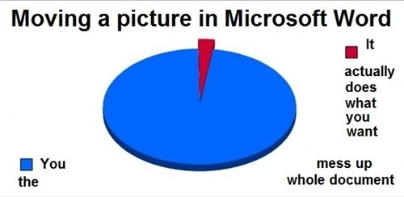
TUGAS
Ubah dokumen dari 2. SebelumFormat - Laporan Skripsi.docx menjadi seperti 2. Setelah Format - Laporan Skripsi.pdf.
Kirimkan dalam format MS Word!

